Slide 1

AMAZON WEB SERVICES (Applied Data Science) Session 1
Dr. Nilay Karade
Program Manager

Slide 2

Know Your Mentor
Qualification
Ph D in AI
Master in Computer Application
15 Years of experience
Software Industry
Data Science consultant
Web developer
Mobile app developer
Teaching
Corporate Trainer
Associate Professor
Assistant Professor
Areas of specialization
AI & Data Science
Web and android app development
Cloud computing
MLOps
BI
Publications – Books, Research papers
Dr. Nilay Karade
www.linkedin.com/in/dr-nilay-karade
nilayk@regenesys.net

Slide 3
Ground rules
Punctuality: Students should log in to the online class on time and be ready to participate actively.
Respect and Courtesy: All participants, including students and teachers, should treat each other with respect and courtesy. Avoid interrupting others while they are speaking and refrain from using offensive language or behavior.
Mute and Unmute: Students should keep their microphones muted when not speaking to minimize background noise. Teachers can remind students to unmute when they want to participate or ask questions.
Raise Hand: Encourage students to use the "raise hand" feature in the online platform to indicate they want to speak or ask a question. This helps maintain order during discussions.
Camera Usage: While it's not always mandatory, encourage students to turn on their cameras during the class. Seeing each other's faces fosters a sense of connection and engagement.
No Distractions: Students should find a quiet and distraction-free space to attend the class. Avoid multitasking or engaging in activities unrelated to the class.
Tech Troubles: If students encounter technical issues, they should inform the teacher or the IT support team promptly.
Privacy and Confidentiality: Students should respect the privacy of their peers and teachers. Avoid sharing class materials, recordings, or discussions with individuals outside the class.
Notes:
Ground rules for online classes are essential to maintain a productive and respectful learning environment. These rules set clear expectations for both students and teachers, ensuring that everyone can engage effectively and make the most of the online learning experience. Here are some common ground rules for online classes:

Slide 4
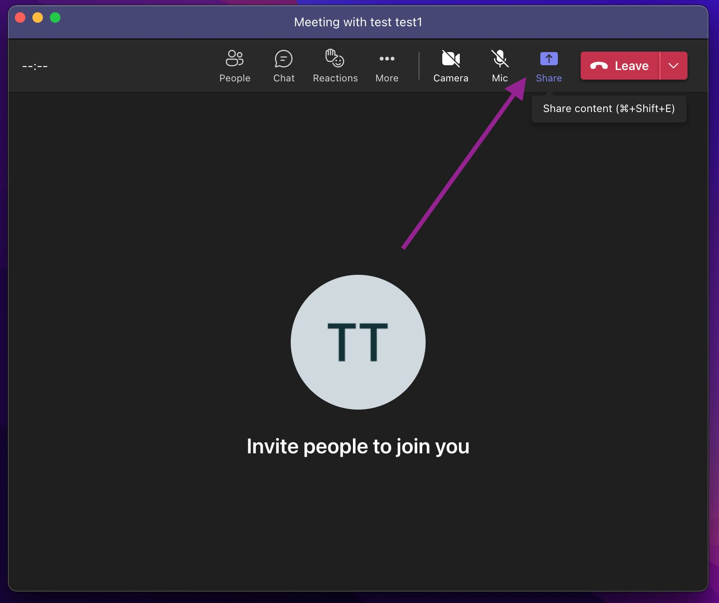
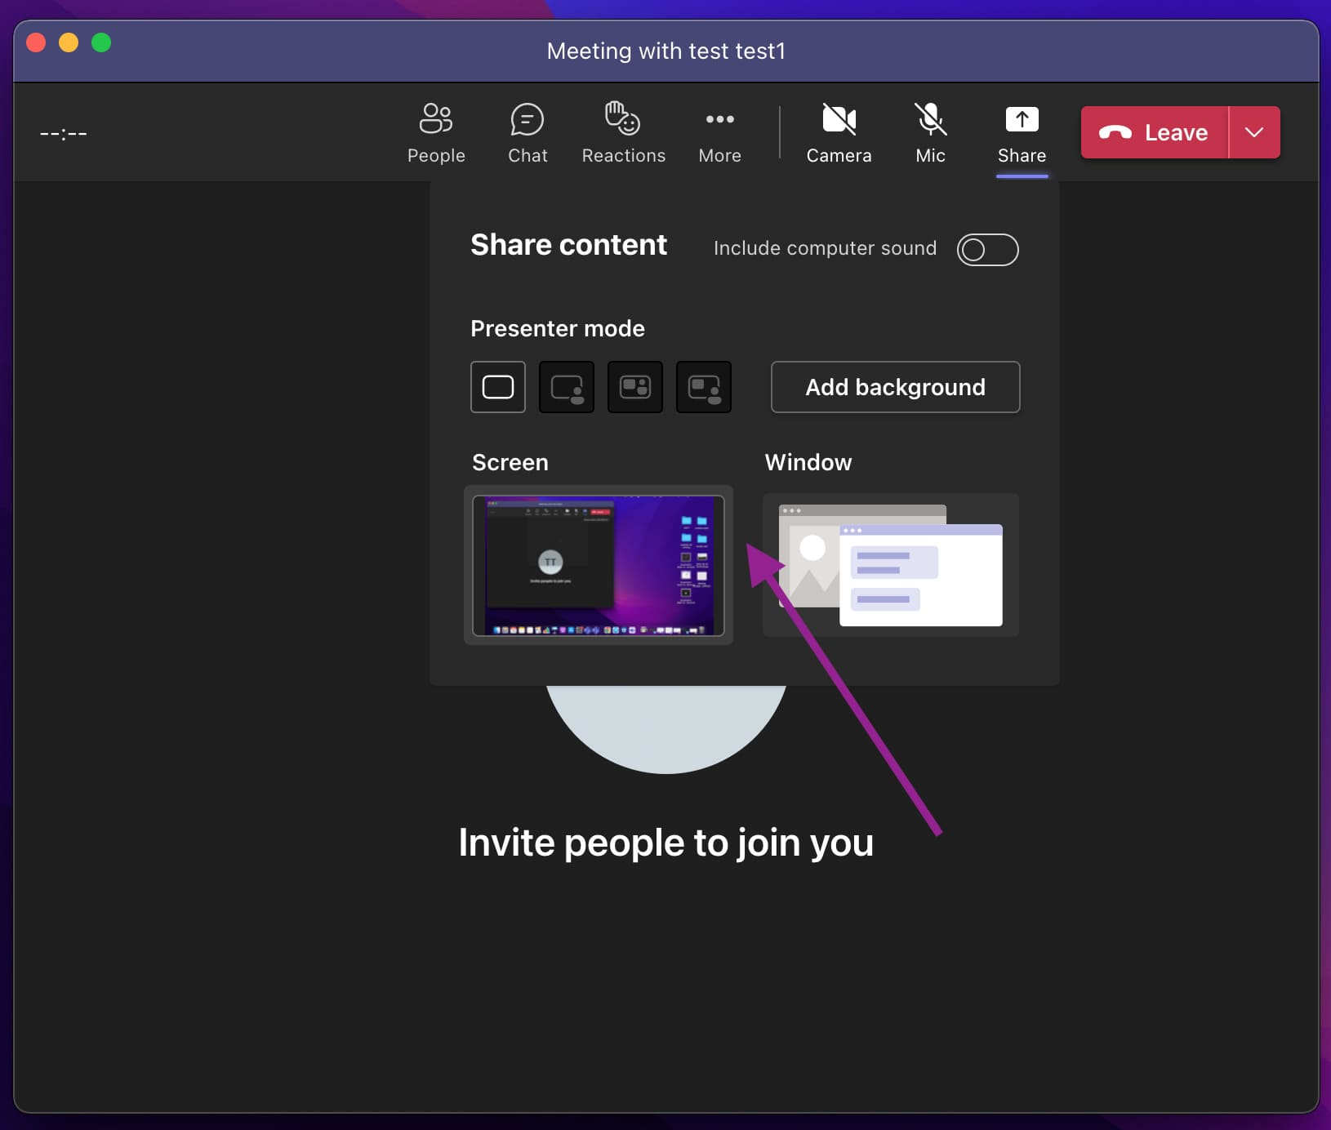

Ground rules
Source: https://www.helpwire.app/blog/share-screen-on-microsoft-teams/

Slide 5
AMAZON WEB SERVICES (AWS)
Session 1
Introduction cloud computing
AWS account setup
AWS services overview
AWS Budget, billing, alarm
Session 2
S3 bucket storage
Command line interface
Identity access management

Slide 6
AMAZON WEB SERVICE (AWS)
Session 3
Elastic cloud computing
Deploy Flask AI App using PuTTY, WinSCP, and Linux Commands
Session 4
SageMaker
Notebook instance
Inference tool for ML model
Endpoints using gateway API
Testing app using Postman
Session 5
Vision/Speech API

Slide 7
Agenda
What is cloud computing?
AWS account setup
Overview of AWS services
Budget & billing
Simple storage system (S3)

Slide 8
Client server architecture

Slide 9
Scaling up infrastructure

Slide 10
Scaling up infrastructure to the next level

Slide 11
Solution is cloud computing

Slide 12
Characteristics of cloud
Easy to maintain, deploy
Cheaper
On demand
Multi-tenancy
Measured services - Pay as you go pricing

Slide 13
Types of cloud deployment
Private
Public
Hybrid

Slide 14
Amazon Web Services (AWS)
It is a comprehensive cloud computing platform provided by Amazon that offers a wide range of cloud services and solutions to individuals, businesses, and organizations.
AWS allows users to access a variety of on-demand computing resources over the internet, including
computing power,
storage,
databases,
machine learning,
analytics,
networking, and more.

Slide 15
AWS free tier account setup
Please refer PDF

Slide 16
AWS regions

Slide 17
AWS Services
AWS Login
AWS console
AWS Service search box
AWS Region on account page
AWS Global infrastructure
Source: https://aws.amazon.com/free

Slide 18
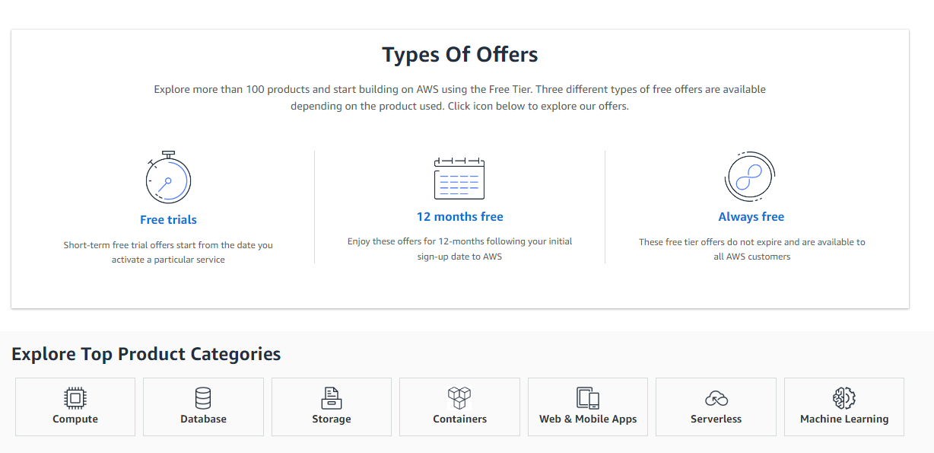
AWS Services
Source: https://aws.amazon.com/free

Slide 19
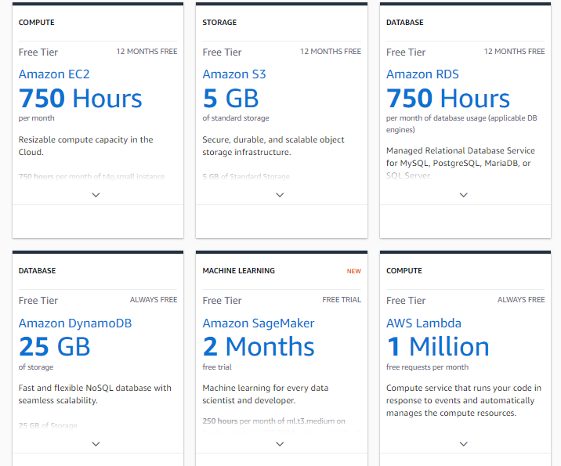
Source: https://aws.amazon.com/free

Slide 20
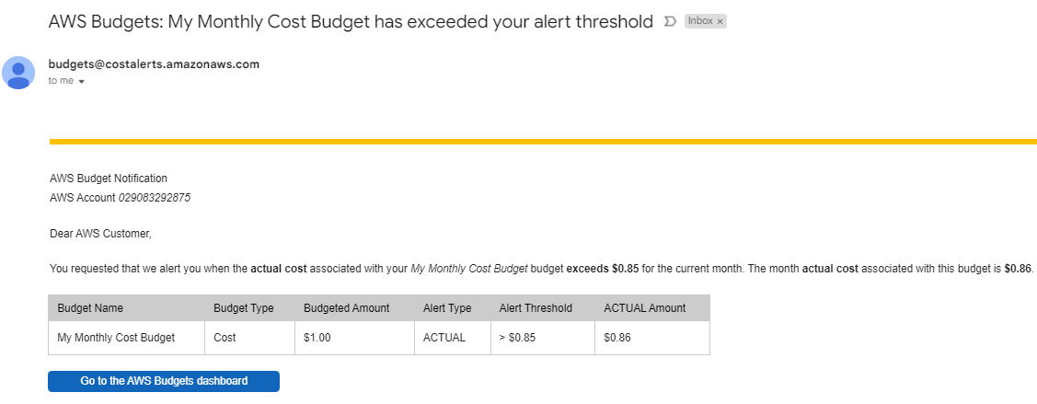
AWS Budget & Billing

Slide 21
AWS Budget & Billing
AWS Alarm

Slide 22
Amazon Simple Storage Service (S3)
Amazon Simple Storage Service (S3) is a highly scalable and durable object storage service provided by Amazon Web Services (AWS).
It allows users to store and retrieve virtually any amount of data in the cloud, making it one of the most popular cloud storage solutions available.
An S3 bucket is a container used to store objects (files) in S3. Buckets have a unique name globally across all AWS accounts.
It is used in the URL to access the objects stored in the bucket.
S3 allows you to create multiple buckets, and each bucket can store an unlimited number of objects.

Slide 23
Operations Performed with S3
Create a Bucket: Users can create an S3 bucket through the AWS Management Console, AWS CLI, or SDKs. The bucket name, region, and access control settings need to be specified during the creation process.
Upload Objects: Users can upload objects (files) to an S3 bucket. These objects can be of any type, such as images, videos, documents, etc. Users can upload objects through the AWS Management Console, AWS CLI, SDKs, or directly using pre-signed URLs.
Download Objects: Objects stored in an S3 bucket can be downloaded by users with the appropriate permissions. Users can download objects through the AWS Management Console, AWS CLI, SDKs, or using direct URLs.
Manage Object Permissions: S3 allows fine-grained control over object access permissions. Users can set permissions for objects at the bucket level or at the individual object level. This includes granting read, write, and delete permissions to specific users or groups.
Versioning: S3 provides versioning support, allowing users to keep multiple versions of an object. This feature helps in maintaining data integrity and recovering from accidental deletions.
Server-Side Encryption: S3 allows users to enable server-side encryption for their objects. This ensures that the data stored in S3 is encrypted at rest, providing an additional layer of security.
Lifecycle Policies: S3 offers lifecycle policies that automate the management of objects based on predefined rules. Users can define policies to transition objects to cheaper storage classes or delete them after a specified period.
Static Website Hosting: Users can host static websites by enabling static website hosting on an S3 bucket. This allows the bucket to serve HTML, CSS, JavaScript, and other files to users as a public website.

Slide 24
Assignments - 1
Create a Bucket
Upload Objects
Download Objects
Manage Object Permissions
Versioning
Server-Side Encryption
Set Lifecycle Policies

Slide 25
Assignments - 2
Budget

Slide 26
Summary
What is cloud computing?
AWS services
S3 storage
Objects

